Slide 1
February 2024
CHANNEL FUSION’S DIGITAL SERVICES
TURNKEY DIGITAL SERVICES

Slide 2
CASE STUDY

Slide 3
PROMOTIONS – A CASE STUDY FOR DOUBLE-DIGIT GROWTH
Channel Fusion’s Digital Team created turnkey integrated digital advertising packages to work in tandem with national promotions for a major tire manufacturer to help them sell more tires through their local dealers.
Keys to success
Turnkey Packages
The brand covered a portion
Simple sign up
Channel Fusion pulled funds directly from the co-op program - no out-of-pocket expenses
Measured everything
Digital Team tied tire unit sales to the marketing effort - closing the ROI loop.
+15.8%
All information is proprietary to Channel Fusion and cannot be shared without written consent
Notes:
Here’s a look at our search advertising in action – and how in combination with a little social content and landing pages – all designed to coordinate and work together, we were able to drive double digit sales growth.
In my experience, the more coordinated a campaign is, the more effective it is. Building and optimizing comprehensive digital marketing campaigns is where my skills really come to life. And coupling that with Sue’s incredible data analysis skills, we were able to deliver some really stellar results to Michelin,, and managed to sell a bunch of tires too!
Our Digital team created turnkey integrated digital advertising packages to work in tandem with national promotions for a major tire manufacturer to help them sell more tires through their local dealers.
Keys to success
Packages were turnkey
The brand covered a portion of the advertising
Dealers were able to sign up easily
Channel Fusion’s Digital Services were able to pull funds directly from the co-op program , so there were no out-of-pocket expenses
Everything about the campaign was measured
We analyzed the campaign and tied tire unit sales to the marketing effort to help the brand close the ROI loop.

Slide 4
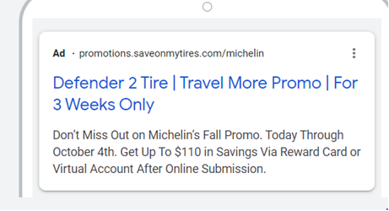
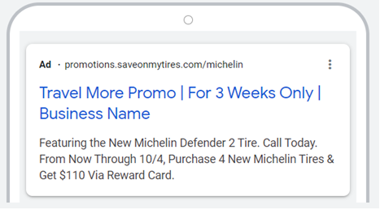
THE ADVERTISING
Google Search Advertising
Focused solely on text ads
Targeted consumers lower in the sales funnel who were “in-market” for tires
Optimizations implemented each week after KPI reviews & optimization meetings
All information is proprietary to Channel Fusion and cannot be shared without written consent

Slide 5
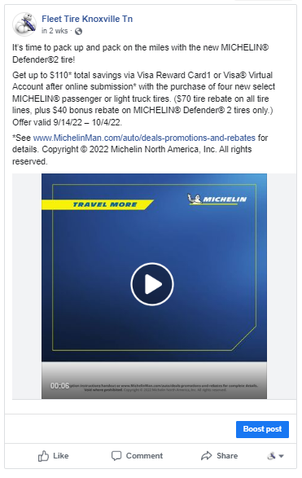
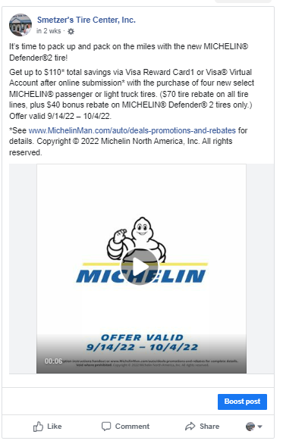
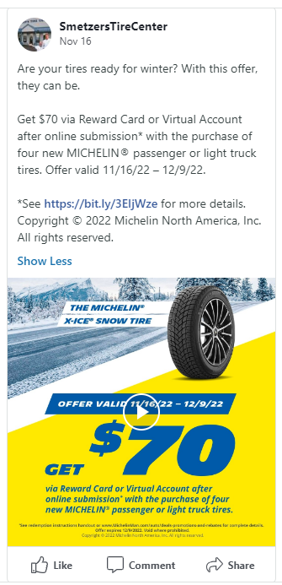
THE SOCIAL CONTENT
Facebook Posts
Cover Photos
Organic Facebook Content
We included organic social content with each promotion to drive additional interest

Slide 6
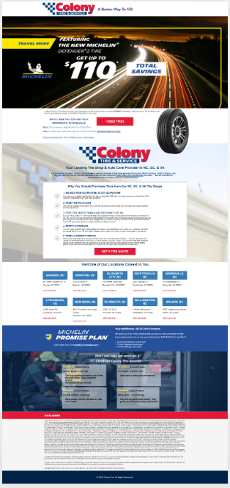
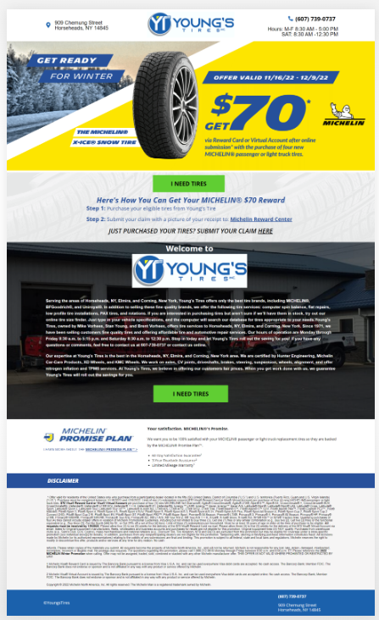
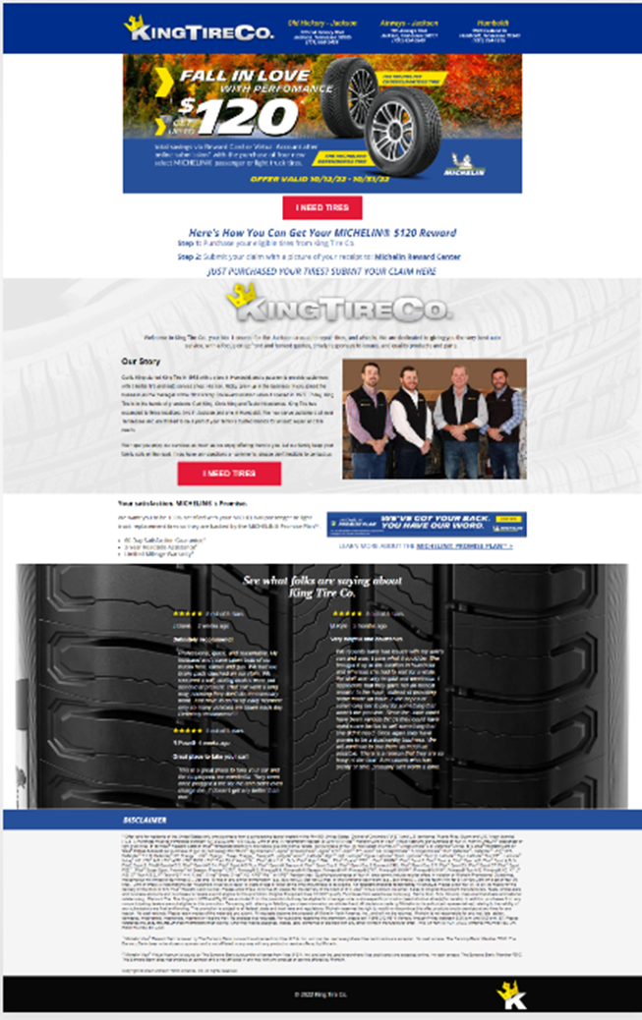
THE LANDING PAGE
Dedicated Campaign Landing Pages
Personalized for each dealer
Offers rotated out with each promotion
Optimizations made each month
Leads sent to dealers in real time for follow-up
All information is proprietary to Channel Fusion and cannot be shared without written consent
Notes:
This really helped having dedicated LP’s
Because coordinated campaign specific LP’s always get better conversion rates
Because not all dealer websites are created equally, so if we send traffic from our professional looking campaigns to a website that was done by someone’s nephew, there’s a disconnect for the visitor and they’re less likely to convert.

Slide 7
THE KPI’s
Search Ads
Avg CTR – 7.64% (Automotive industry avg is 4%)
Avg CPC – $1.54 (Automotive industry avg is $2.46)
Avg 2,299 clicks and 30.1k impressions for each dealer over the course of 4 promotions
Landing Page
2,320 visitors per dealer (across all 4 promos)
2,835 views
On page conversion rate of 20.6% (includes any click, call or form submission)
# of on-page leads for each dealer – avg of 65.6 leads across 4 promos
All information is proprietary to Channel Fusion and cannot be shared without written consent
Notes:
Google Ads Results (All promos):
This shows that we have the tire industry dialed in after doing digital marketing in the tire space for 8 years.
Avg CTR – 7.64% (Automotive industry avg is 4%) –our own avg was 5.1%
Avg CPC - $1.54 (Automotive industry avg is $2.46) –our own avg was $1.61
Avg’ed 2,299 clicks and 30.1k impressions for each dealer
Landing Page Results (All promos):
2,320 visitors per dealer
2,835 views – so many came back after their initial visit
On page conversion rate of 20.6% (which includes any click, call or form submission)
# of on page leads for each dealer – avg of 65.6 leads across 4 promos
Our main goal for this advertising was really to drive traffic in-store. (This is not easily or affordably measured)
But really these are all just vanity metrics. They don’t mean a thing unless we actually sell more tires...

Slide 8
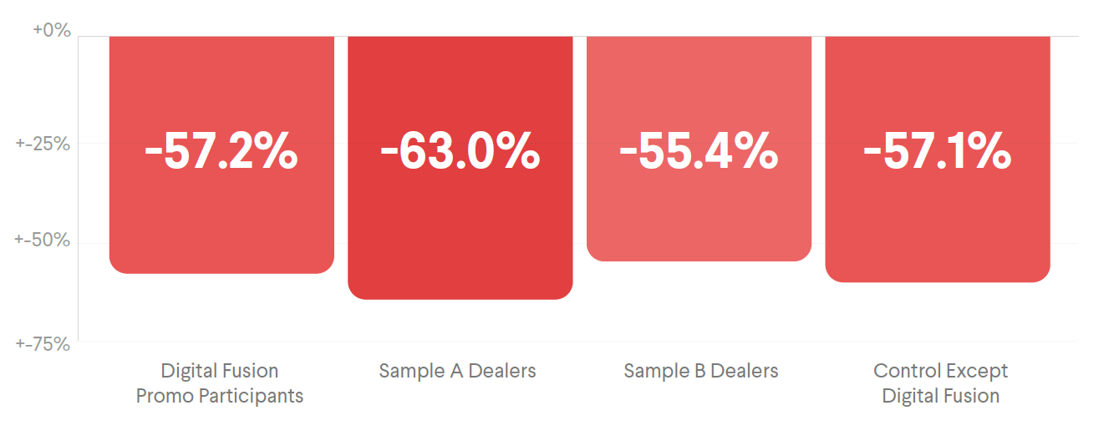
THE TIRE SALES – BEFORE PROMOS BEGAN
All information is proprietary to Channel Fusion and cannot be shared without written consent
Notes:
In August before promos began, all dealers saw sales that were down compared to prior year, so everyone began on an even playing field.

Slide 9
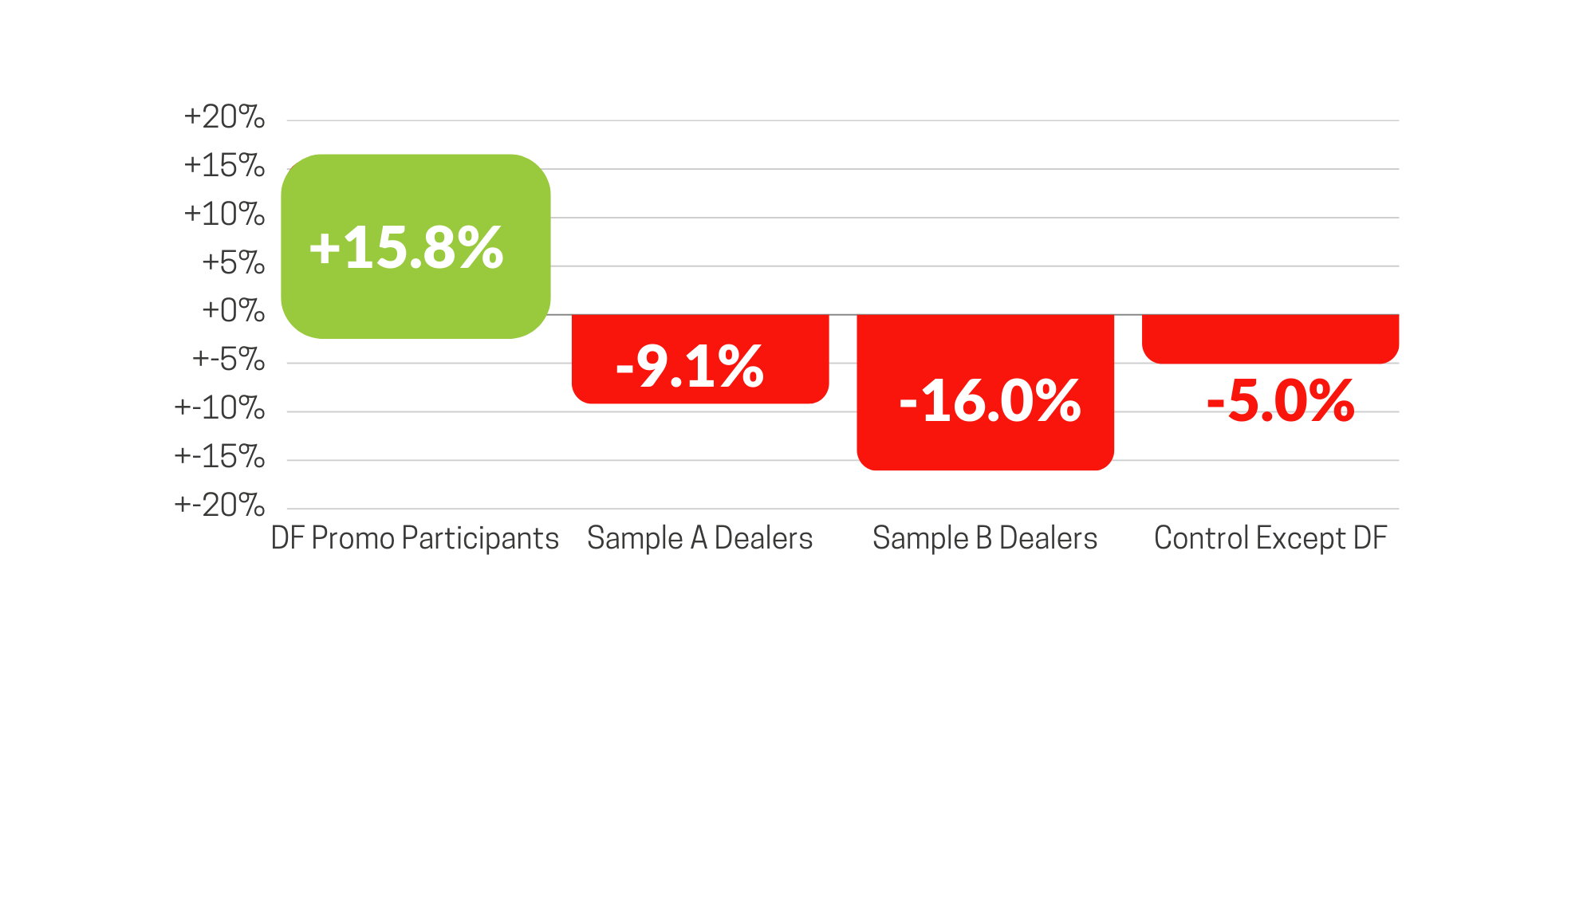
THE TIRE SALES – AFTER PROMOS
Compared to Prior Year Sales
All information is proprietary to Channel Fusion and cannot be shared without written consent
Notes:
Total unit sales for Sept. through Nov. 2022 were up +16% year over year for the dealers who participated in the program, outperforming all other groups.
Sample A (8 similar-sized dealers) were down -9.1%
Sample B (8 similar-sized dealers) were down -16%
Control group (excludes all participating dealers) were down -5.0%

Slide 10
FEEDBACK FROM A DEALER
Delaware Tire LOVES this promotion as they are getting consumers in the door and buying.
All information is proprietary to Channel Fusion and cannot be shared without written consent
Notes:
This is a quote from a brand sales rep regarding what his dealer said about our digital program – the bad news was this dealer hadn’t signed up until last promo. They signed up for all promos the next year.

Slide 11
THE NEXT ITERATION – QR CODE CAMPAIGNS
Hover over image to play video
All information is proprietary to Channel Fusion and cannot be shared without written consent
Notes:
We wanted to come up with a way to further close the ROI loop for Michelin so we came up with this solution to run similar campaigns while giving dealers the ability to tie actual in-shop sales directly to the marketing effort.

Slide 12
SIMILAR CAMPAIGN EXPERIENCE APPLIED TO HVAC DEALERS

Slide 13
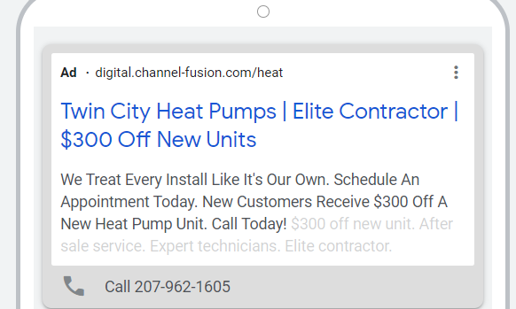
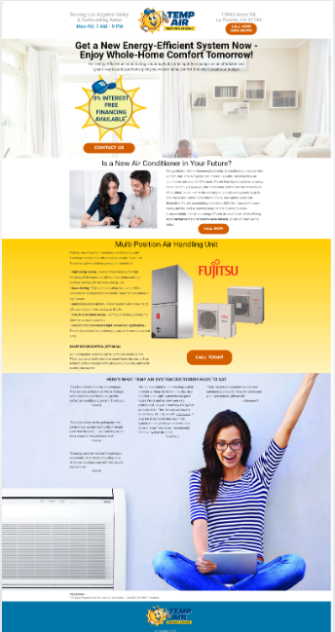
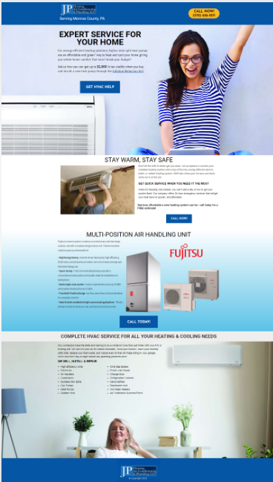
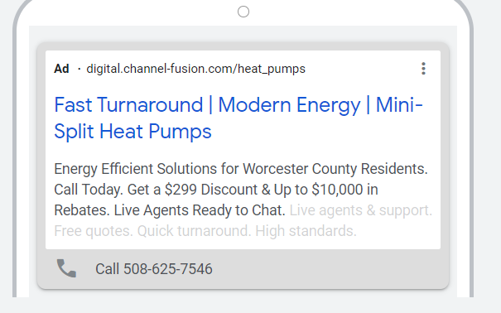
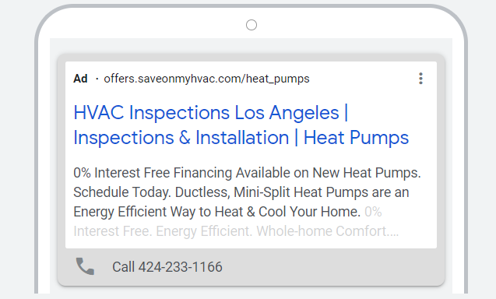
HVAC
Search Ad Examples
Landing Page Examples
We included:
Search Advertising
Dedicated Landing page
Call Rail phone lead tracking
Campaign Optimizations
Monthly Reporting

Slide 14
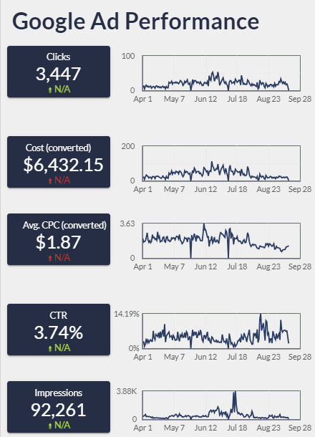
HVAC – KPI’S
3 Month Campaign Averages
Google Search Ads
Spend: $2,150
CTR: 3.74%
CPC: $1.87
Calls/Contractor: 11
Form Leads/Contractor: 10
Notes:
https://lookerstudio.google.com/reporting/84ae7e41-ad15-4d70-b8fa-64109f425a59

