Slide 1
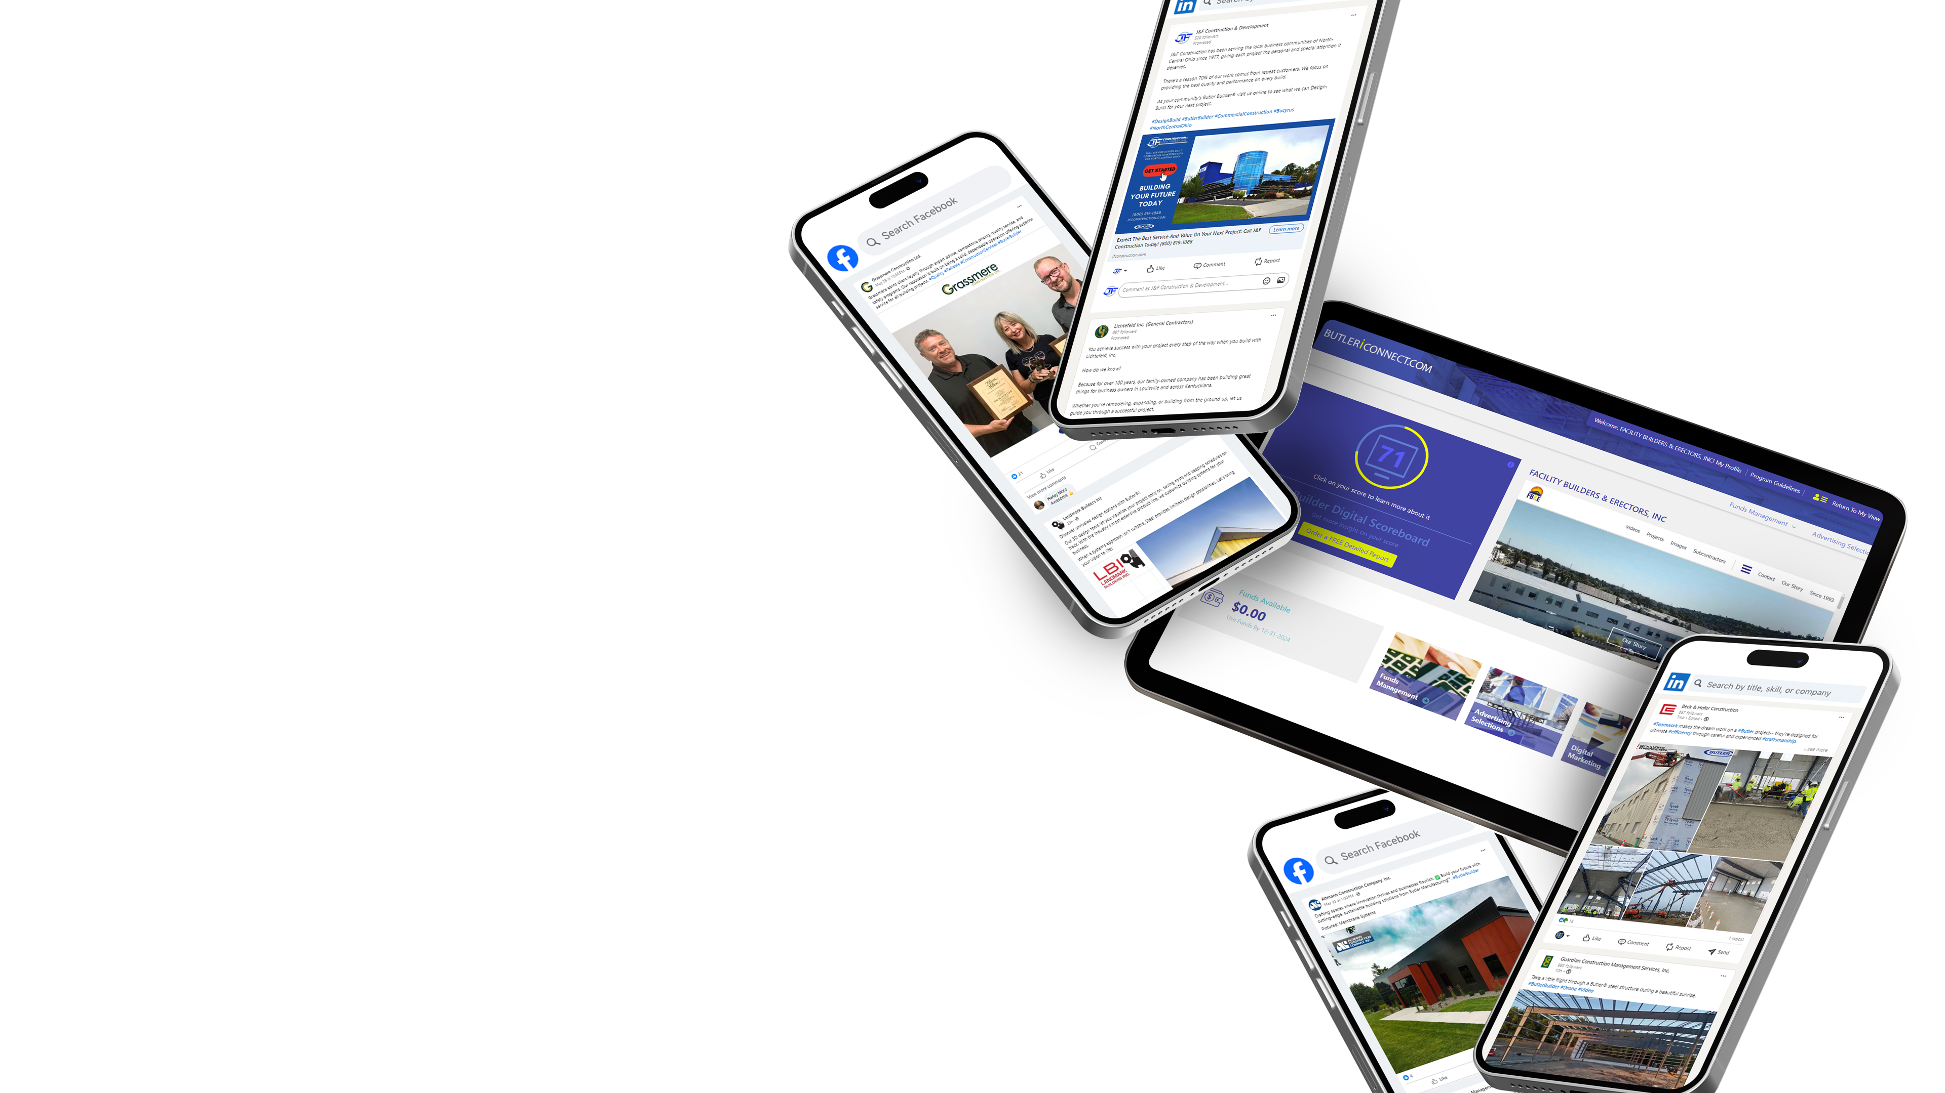
CHANNEL FUSION
DELIVERING CHANNEL PROGRAM OUTCOMES
JUNE 20, 2024

Slide 2
B2B DIGITAL KPI
Growth since hire date

Slide 3
SEARCH – TEXT ADS
B2B SEM Benchmarks:
CTR = 2.41%
CPC = $3.33
Notes:
Sticking with your ad spend and consistency helps to improve
Lots of small optimizations over time
Incorporating landing pages that coordinate specifically with the ad set
Having a promotion really helps in B2C – if we can figure out how to do something similar in the B2B world, I think we could get these to perform even better
Product promos may not make sense for something you’re building 18 months from now, but maybe promos on financing or a discount on something for engaging early (b/c the earlier they engage the builder from site selection on, the more smoothly the process goes for all parties)

Slide 4
SOCIAL MEDIA CONTENT
LinkedIn
Engagement currently running at 10% - another point above last year
Average engagement rate for platform 3%-5%
Continue to have great engagement year over year
Benchmarks: Avg engagement on LinkedIn– 3.16%
Notes:
Focused on content that tells a story and that visitors are interested in
We make sure that content is always relevant to their area – more personalized
We’re also working with your builders to educate them on things like responding to every comment, showing that they’re active with their audience.
Tagging
the companies the builder is building for
Butler – Bruce is really good about liking posts that tag Butler
Hashtags to get more eyes on it – using hashtags that have a high following
Your builders are becoming more top-of-mind as a result

Slide 5
SOCIAL MEDIA CONTENT
Facebook
Engagement currently running at 4.5%
Global – 3.1%, Product & Service – 2.45%, Shopping & Retail 3.17%
Note: We're calculating Engagement rate as Engagements/Impressions
Notes:
Using a lot of video in FB – performing really well there!
Engagement is great on the drone footage
Tagging & hashtags
Decline 2023 due to new algorithms in Facebook and changes to the platform – but we’re figuring it out and back on the uphill swing
Facebook Trends 2023: The Latest Insights
In 2023, the algorithm is AI-driven and designed to deliver personalized content to users that they are most likely to engage with and find valuable.
Increased focus on privacy and security. ...
Greater Emphasis on Groups and Communities. ...
Growth of E-commerce and Online Shopping. ...
Expansion of virtual and augmented reality. ...
Ongoing growth of video content.

Slide 6
SOCIAL MEDIA ADVERTISING
LinkedIn Benchmarks:
CTR All Industries = 0.52%
CPC All Industries = $5.26
Notes:
This shows that we’re getting better at finding the right targets for Butler builders, who are more likely to be interested in what your builders are offering
Constantly testing & optimizing creatives
Optimizing audiences
We noticed a big jump in impressions over PY
We compared 4 builders who were adv on LI last year and still doing so this year, and their impressions were significantly inflated by 19.8%
There was also a pretty significant algorithm change on LI last fall just before Q4 -when we started noticing an increase in impressions (which can, in turn cause CTR to fall off and CPC to go up.) BUT, we are still performing higher or in line with other years and have also not drastically changed our targeting.
This is something we’re keeping a close eye on as the year progresses and June is going back up in CTR, which typically brings down CPC as well.

Slide 7
THANK YOU!
Kelly Magers
+1 319-294-8009
kmagers@channel-fusion.com
www.channel-fusion.com

